Slide 1

Practical Data Science with Python (COSC2670) - Assignment 3
S4068959
Jung-De Chiou

Slide 2
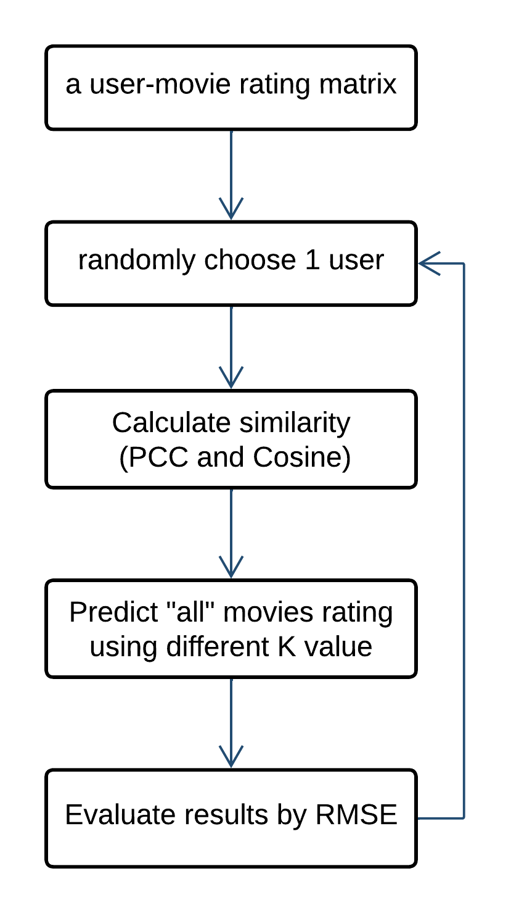
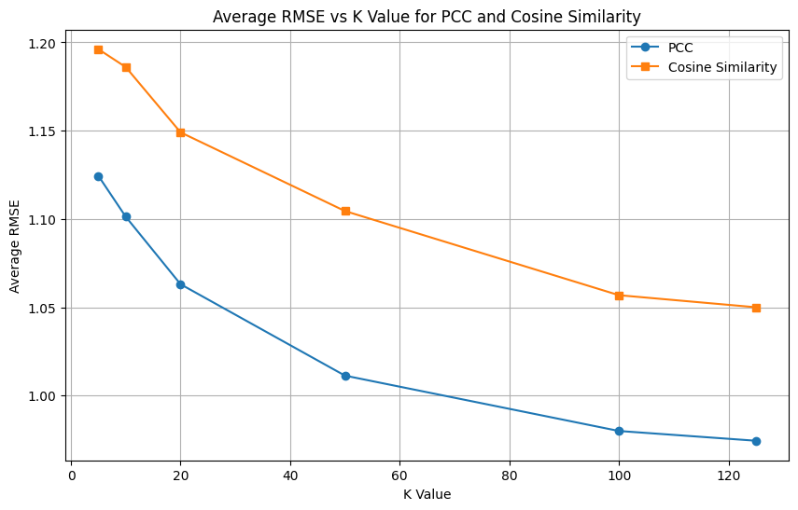
Task1: kNN-based Collaborative Filtering
Original Dataset:
6040 Users, 3883 Movies, 1000209 Ratings
PCC has better performance
K = 125 has lower RSME
▶︎ Run 100 times and plot the average for each K value
※ Detailed calculation can be found in ipynb file
Notes:
First, we load the data. The original data is this amount of users, movies, and rating.
For task1, the step I did as below.
First, we use the loaded data to create a user-item rating matrix. Here the item is movie.
Then we randomly choose a

Slide 3
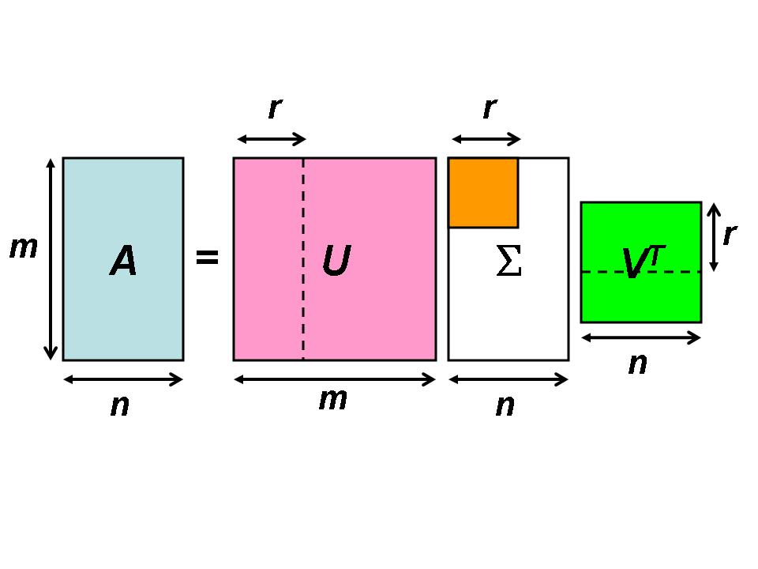
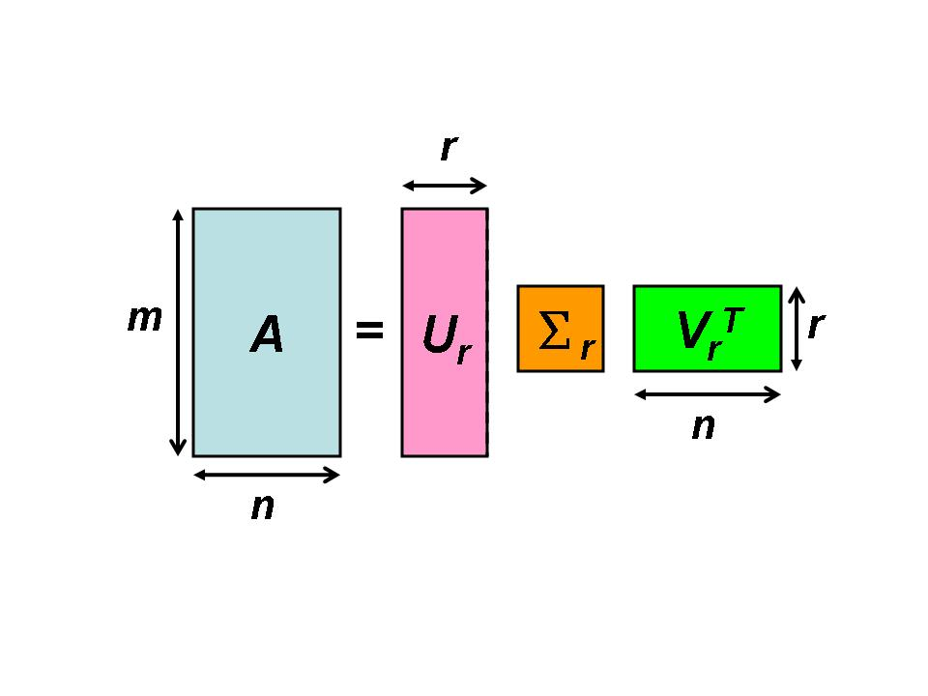
Task2: Matrix Factorization-based Recommendation
SVD（Singular Value Decomposition）:
Singular Value Decomposition (SVD) is a mathematical technique used in linear algebra to decompose a matrix into three other matrices. Specifically, it factorizes a given matrix A into three matrices: U, Σ, and V^{T}
U = It represents the relationships between the rows (e.g., users).
V^{T} = It represents the relationships between the columns (e.g., items).
Σ = These values help identify the dominant latent features in the data.
Truncated SVD:
Truncated SVD is a variant of SVD that is used specifically to reduce the dimensionality of the data by keeping only the most significant components. Instead of decomposing a matrix completely into UΣVT, Truncated SVD only retains the top k singular values and their corresponding vectors. This is particularly useful in handling large, sparse matrices, which are common in applications like natural language processing and recommendation systems.
Phadnis, Neelam & Gadge, Jayant. (2014). Framework for Document Retrieval using Latent Semantic Indexing. International Journal of Computer Applications. 94. 37-41. 10.5120/16414-6065.
Notes:
U = It represents the relationships between the rows (e.g., users).
V^{T =} It represents the relationships between the columns (e.g., items).
Σ = These values help identify the dominant latent features in the data.

Slide 4
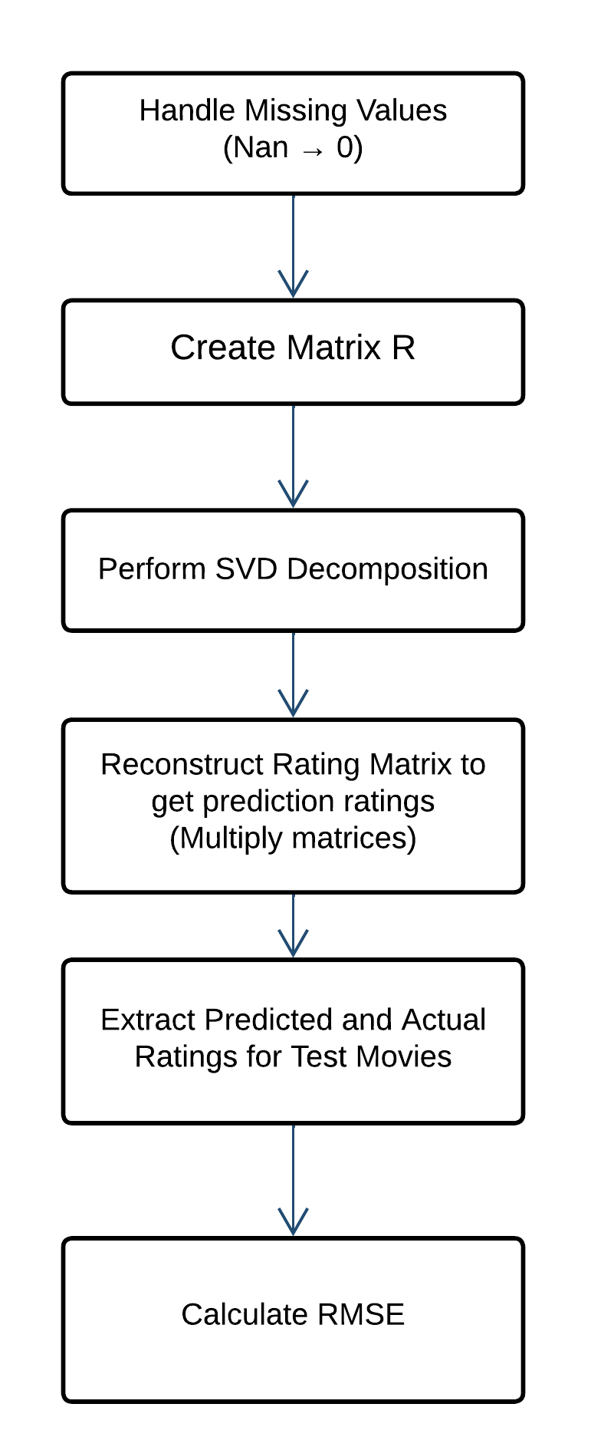
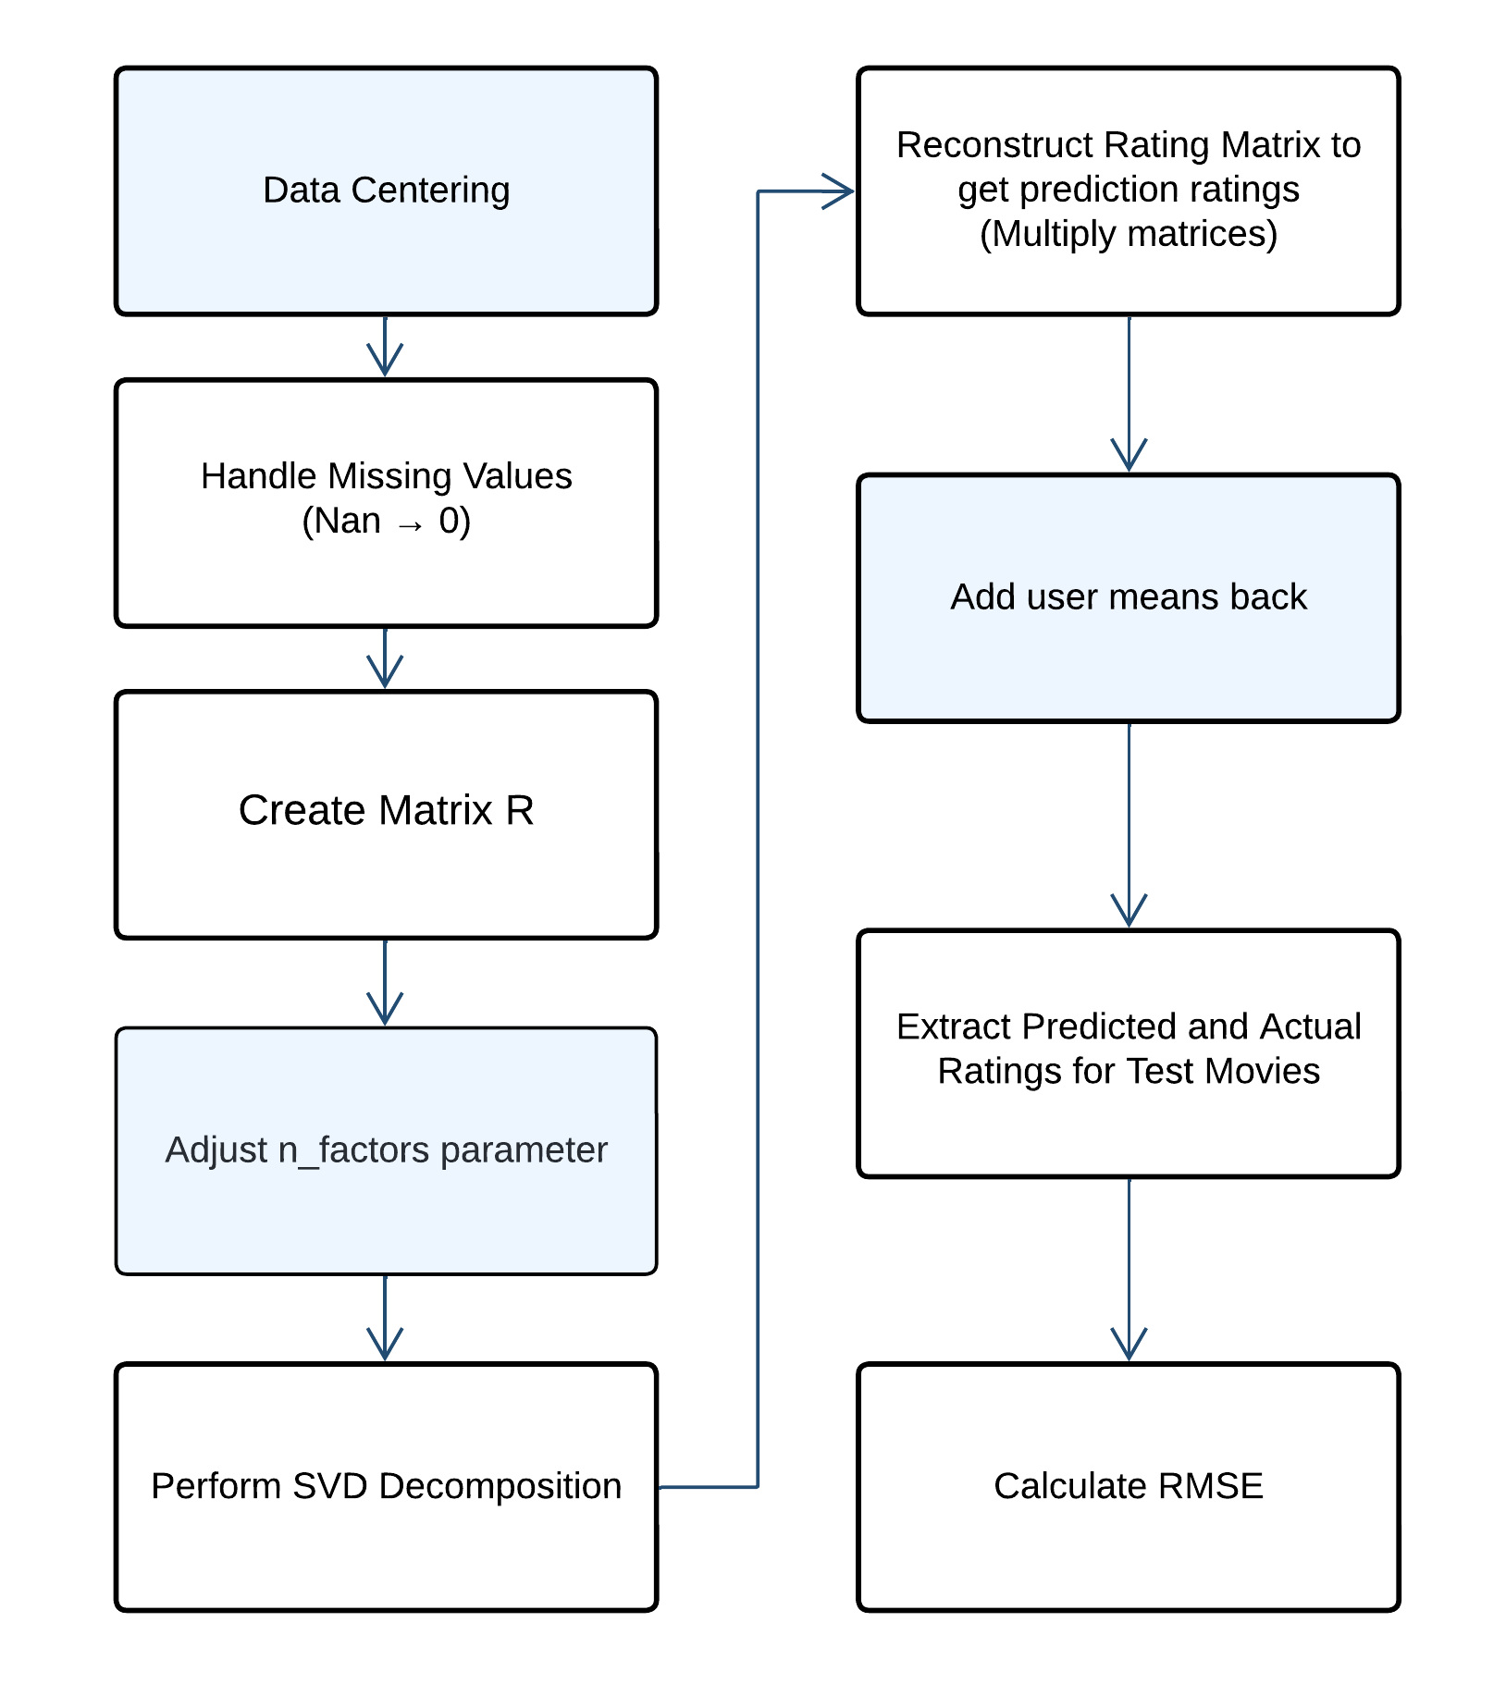
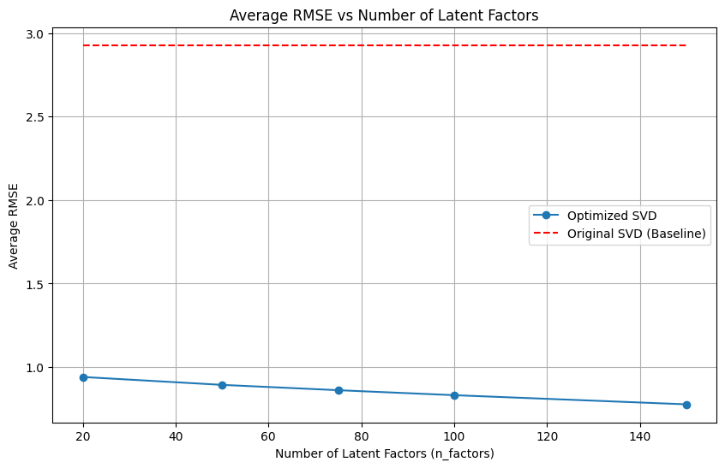
Task2
▶︎ Randomly choose 5 items and predict all users' ratings on these movies.
Truncated SVD
Modified Truncated SVD
Data centering and Adjusting n_factors parameters
Modified SVD performance better than the original one
N_factors = 150 has lower RSME
Restrict n_factors to 150
▶︎ Run 100 times and plot the average for each n_factors value
Notes:
The higher the value of `n_factors`, the more details the SVD can capture when decomposing the user-item matrix, allowing the model to predict more complex preference patterns. However, when `n_factors` is too high, it may lead to overfitting, reducing the model's generalization ability. This means the model may perform very well on the training data but fail to apply effectively to new data. Therefore, I have limited the maximum value of `n_factors` to 150, to achieve a balance between training performance and generalization capability.

Slide 5
Reference
https://scikit-learn.org/dev/modules/generated/sklearn.decomposition.TruncatedSVD.html
https://dataaspirant.com/truncated-svd/

